Slide 1
IDraw
By: Duane Shimmel, Charlotte Whittaker, Derek O’Brien

Slide 2

Target Audience Age 3
123 Color
4/5 stars

Slide 3

In-touch with your work!

Slide 4
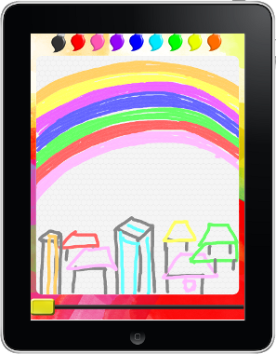
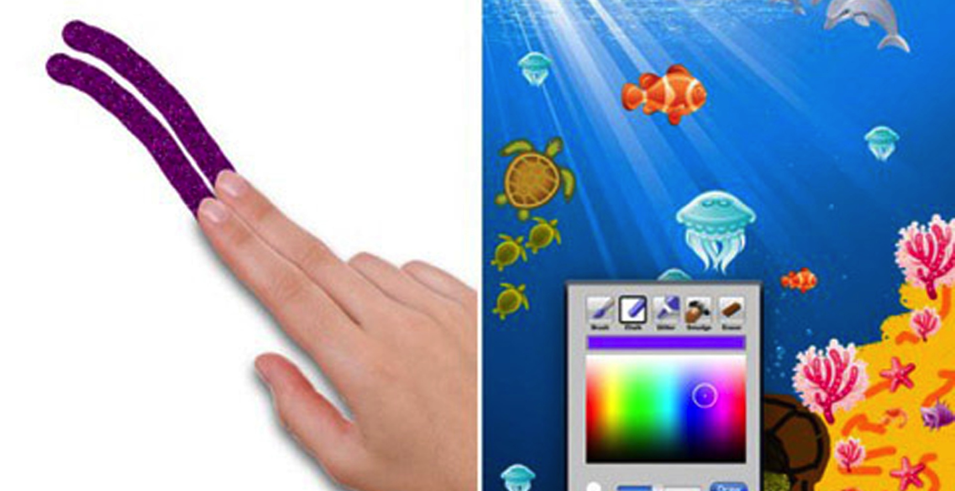
Finger Painting

Slide 5
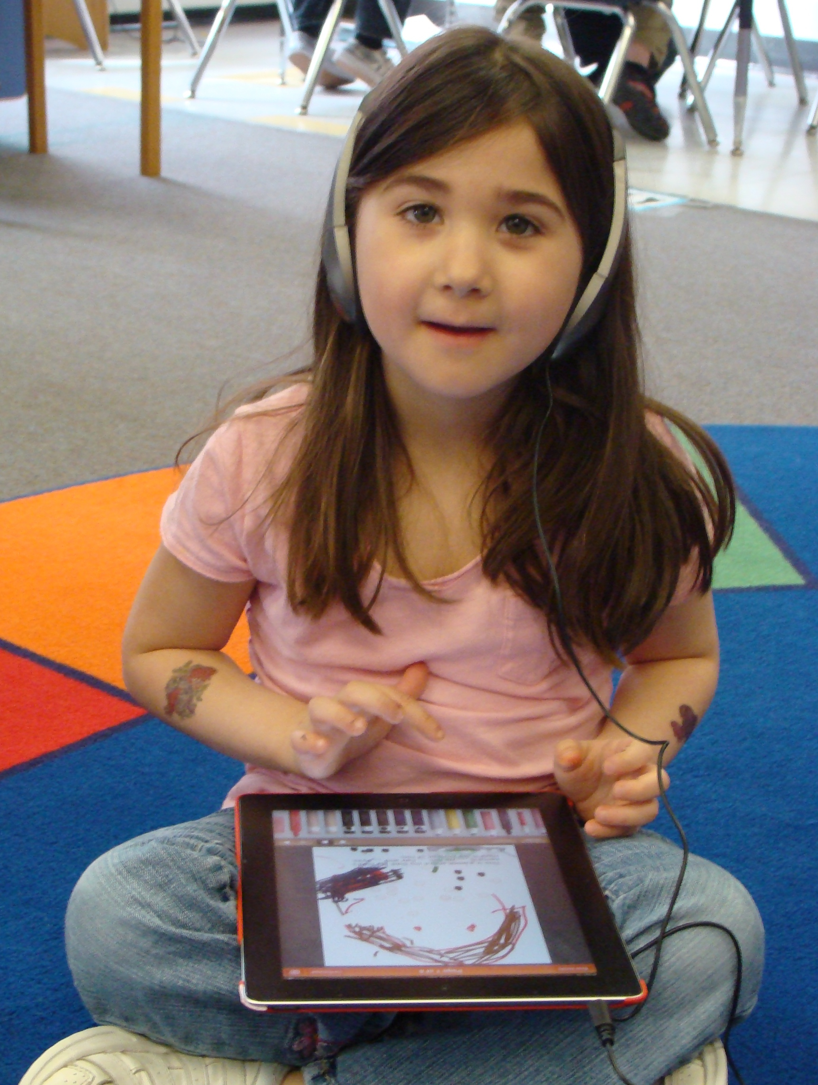
Digital Art

Slide 6


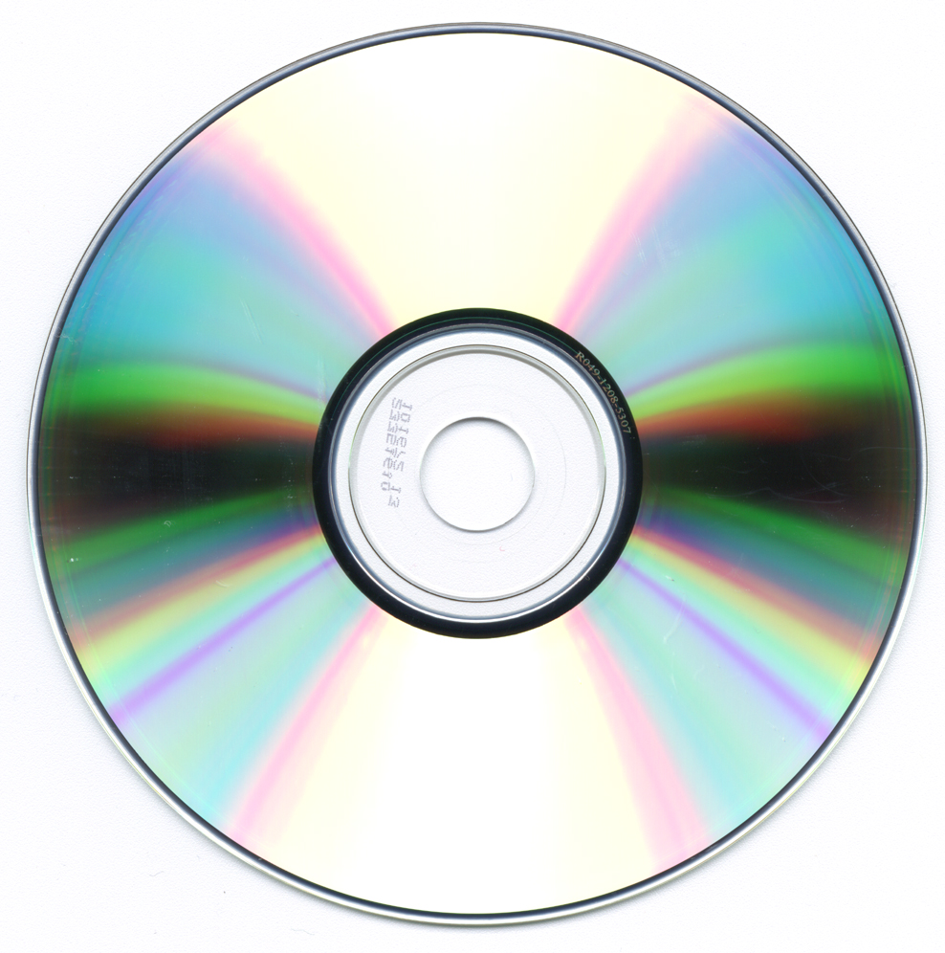
Share

Slide 7
“Art is never finished, only abandoned”
Leonardo da Vinci

